Slide 1
f.r.i.e.n.d.s
The one with the nlp analysis

Slide 2
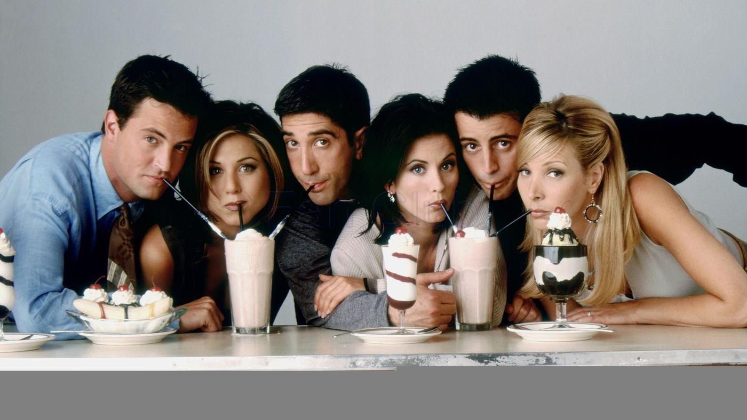
Agenda
Motivation
Data Collection
Features
Text Preprocessing
Sentiment Analysis
Topic Modeling
Future Improvements

Slide 3
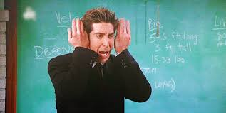
Motivation
How deep is the show FRIENDS?
Are the characters generally happy?
What are the common topics?

Slide 4





Data Collection

Slide 5
Features
Features | Count
Season | 10
Episode | 236
Character | 800
Line | 61,827

Slide 6
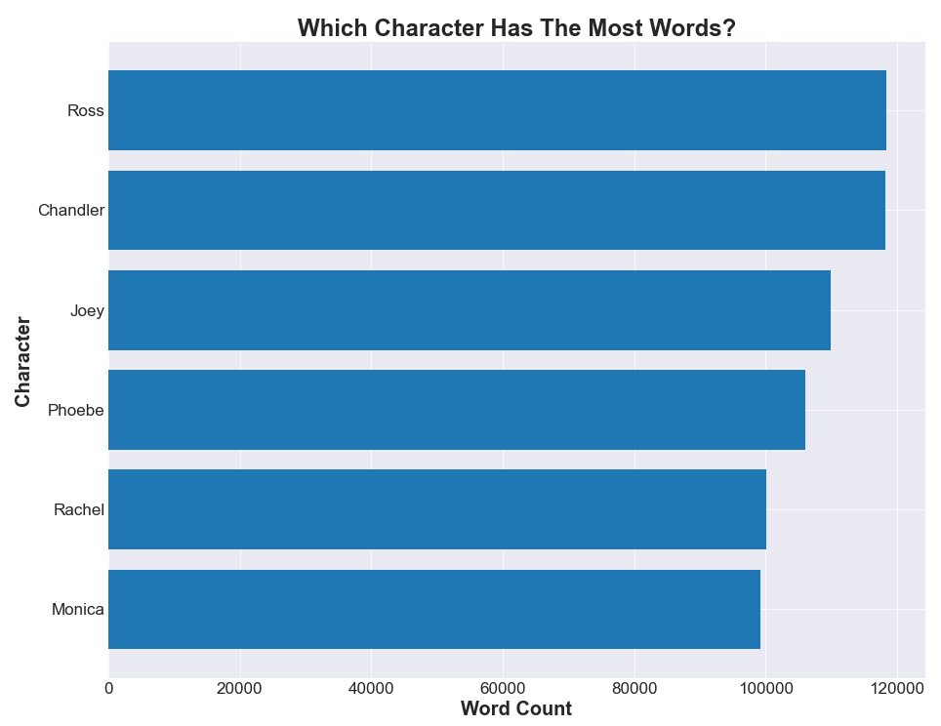
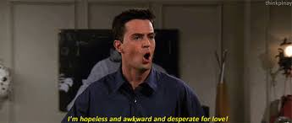
Exploratory Data Analysis

Slide 7

Text Preprocessing
Punctuation
Capital Letters
Numbers
Stop words

Slide 8
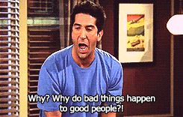
Sentiment Analysis

Slide 9
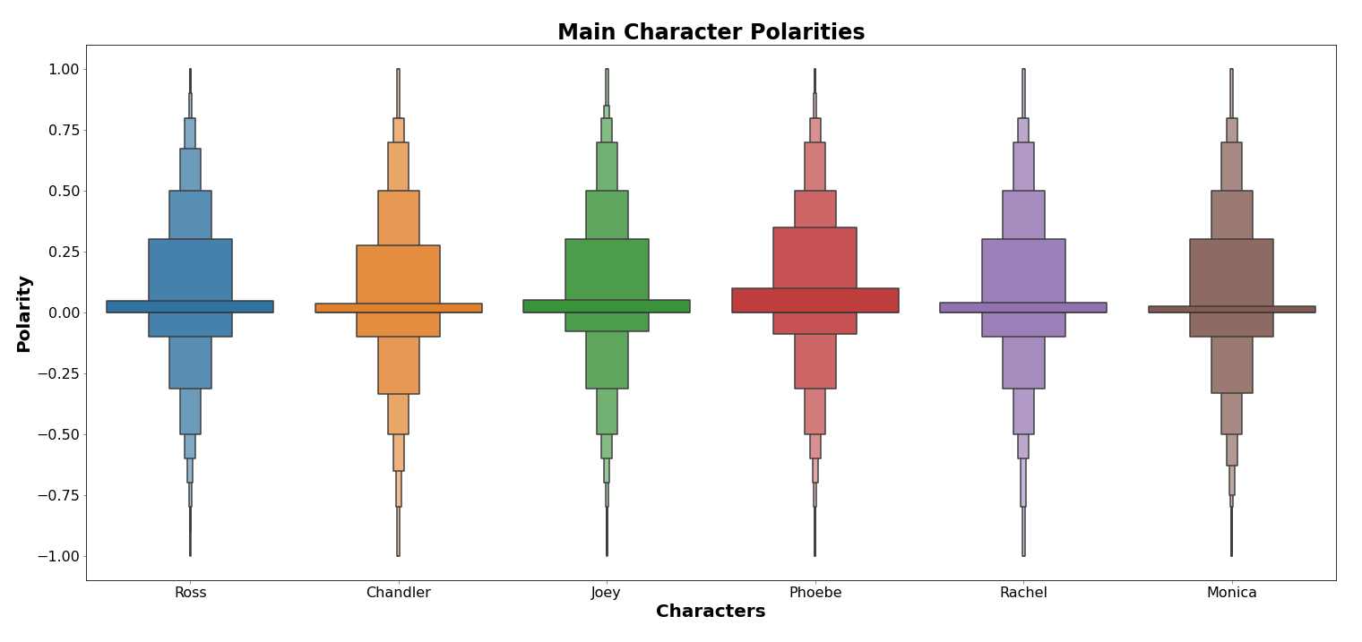
Sentiment Analysis

Slide 10
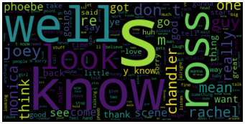
Word Clouds

Slide 11
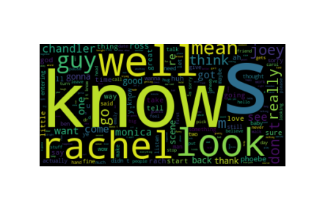
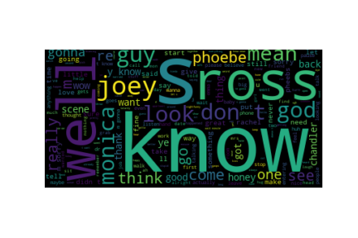
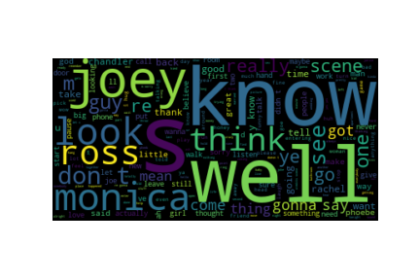
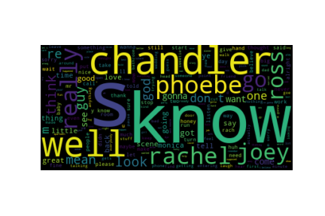
Ross
Rachel
Chandler
Monica

Slide 12
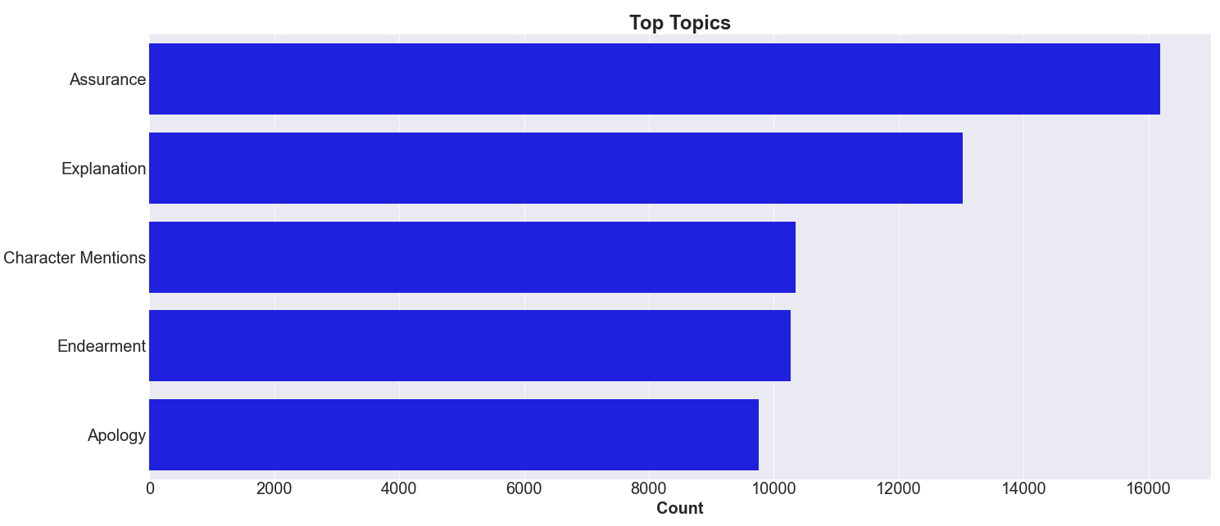
Topic Modeling

Slide 13
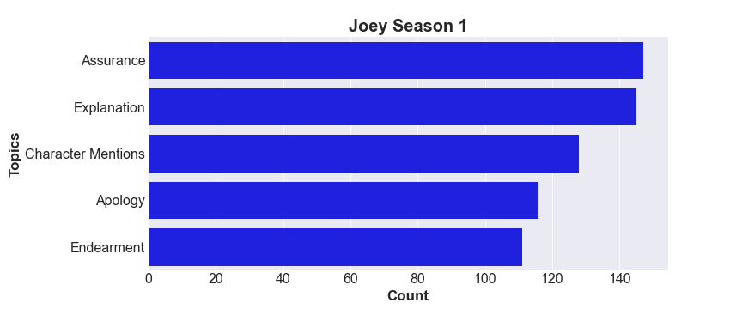
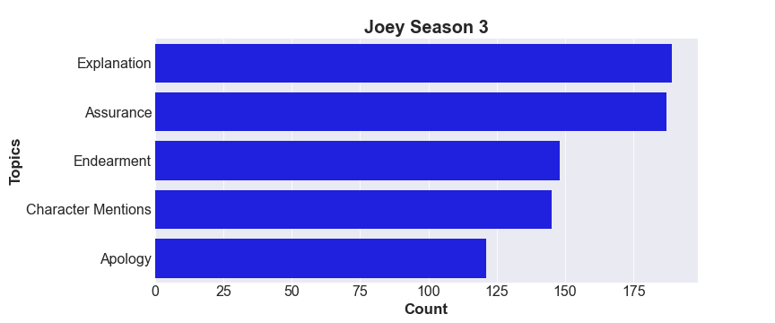
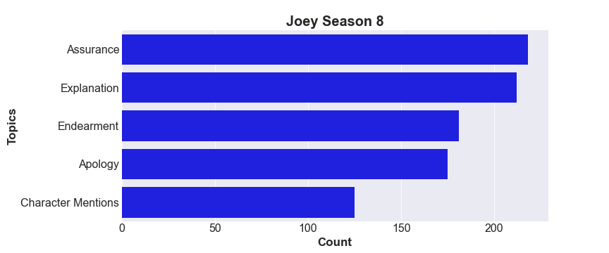
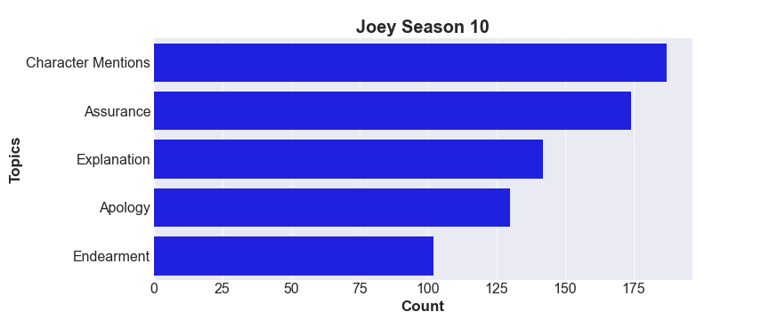

Slide 14

What We’ve Learned

Slide 15

Future Improvements
Script Cleaning
Stop Words
Compare with other Sitcoms

Slide 16
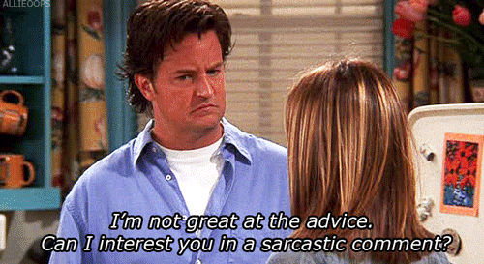
Questions?

